Slide 1




E-LIBRARY SYSTEM
Presented By : Raksha G A & Shreya Gore

Slide 2
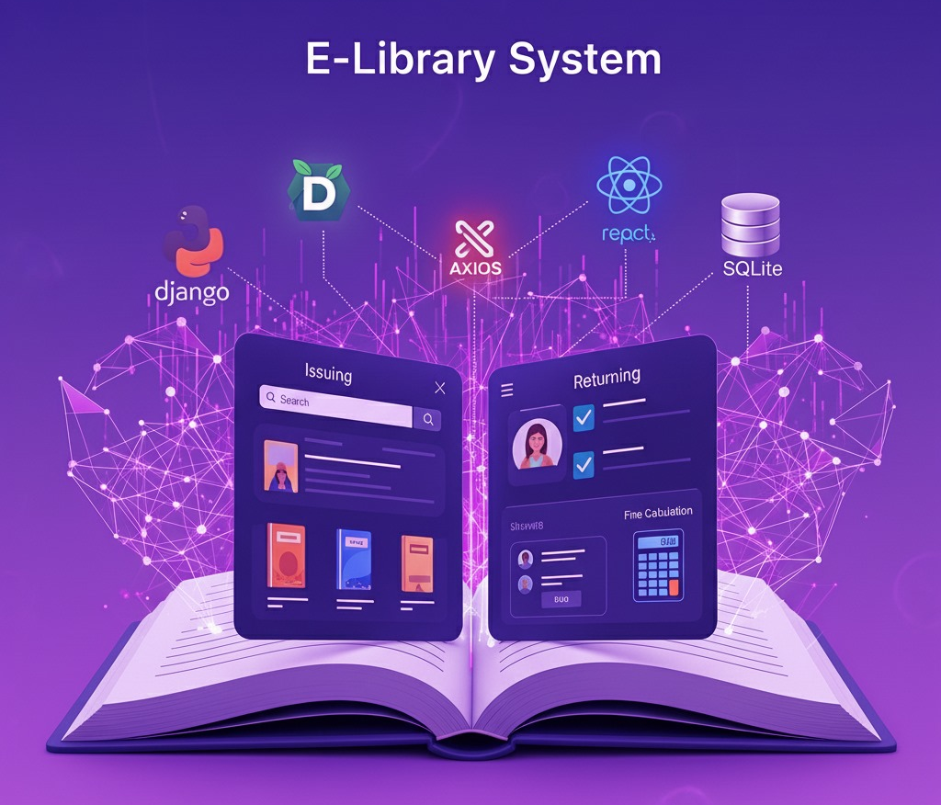

INTRODUCTION
Libraries need a simple way to manage their collection of books and members.
This project is both a console-based (menu-driven) and web-based application.
It automates book issuing, returning, and fine calculation.
Built as a Full-Stack Application:
Backend: Python (Django + REST API)
Frontend: React.js (with Axios)
Database: SQLite

Slide 3

OBJECTIVES
01
02
To create a simple computer-based library system.
To store and manage details of books and users.
03
To provide functions to issue and return books.
04
To keep a transaction history with due dates.
05
To automatically calculate fines for late returns.
06
To develop a user-friendly web interface for easy access and management of the library system.

Slide 4



PROBLEM STATEMENT
Managing library operations manually is slow and error-prone.
It is hard to keep track of which books are available and which are issued.
Late return fines are difficult to calculate without proper records.
There is no simple system to store book/user data permanently.
Hence, a digital solution is needed for effective library management.

Slide 5
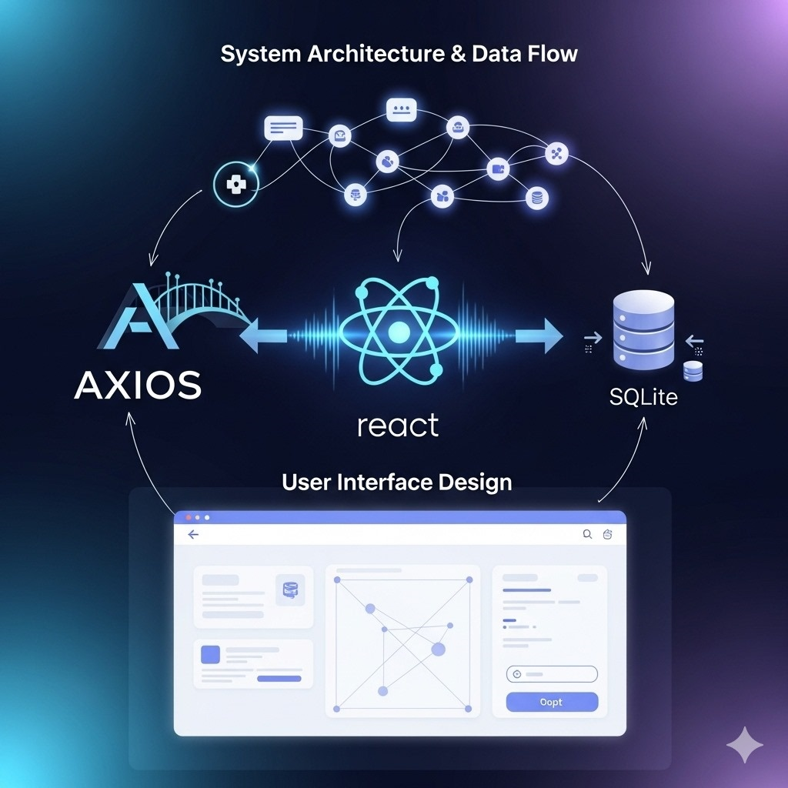
PROJECT OVERVIEW
A complete web-based library management system designed to digitalize core operations.
Frontend: React.js
Backend: Django REST Framework
Database: SQLite
Python Backend Logic: Implements object-oriented principles for managing data, fine calculation, and process automation.

Slide 6


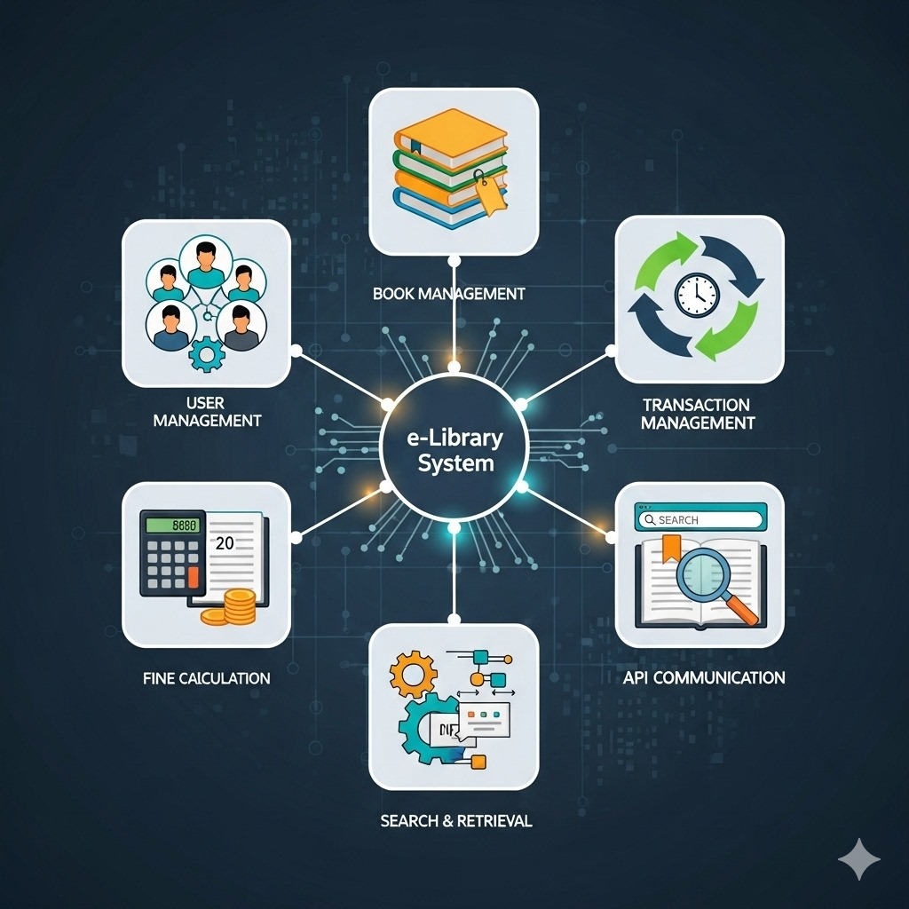
FUNCTIONAL REQUIREMENTS
User Management
Book Management
Transaction Management
Fine Calculation
Display users and books
API Communication

Slide 7
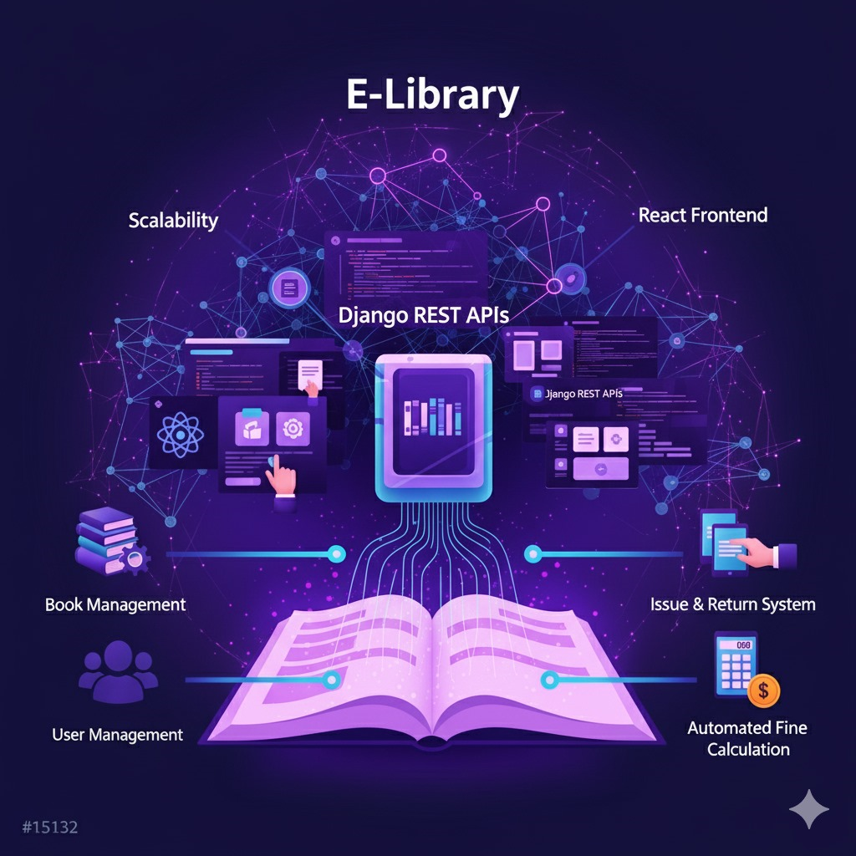
FEATURES
Book & User Management
Issue & Return System
Automated Fine Calculation
React Frontend
Django REST APIs
Scalability
User Friendly

Slide 8
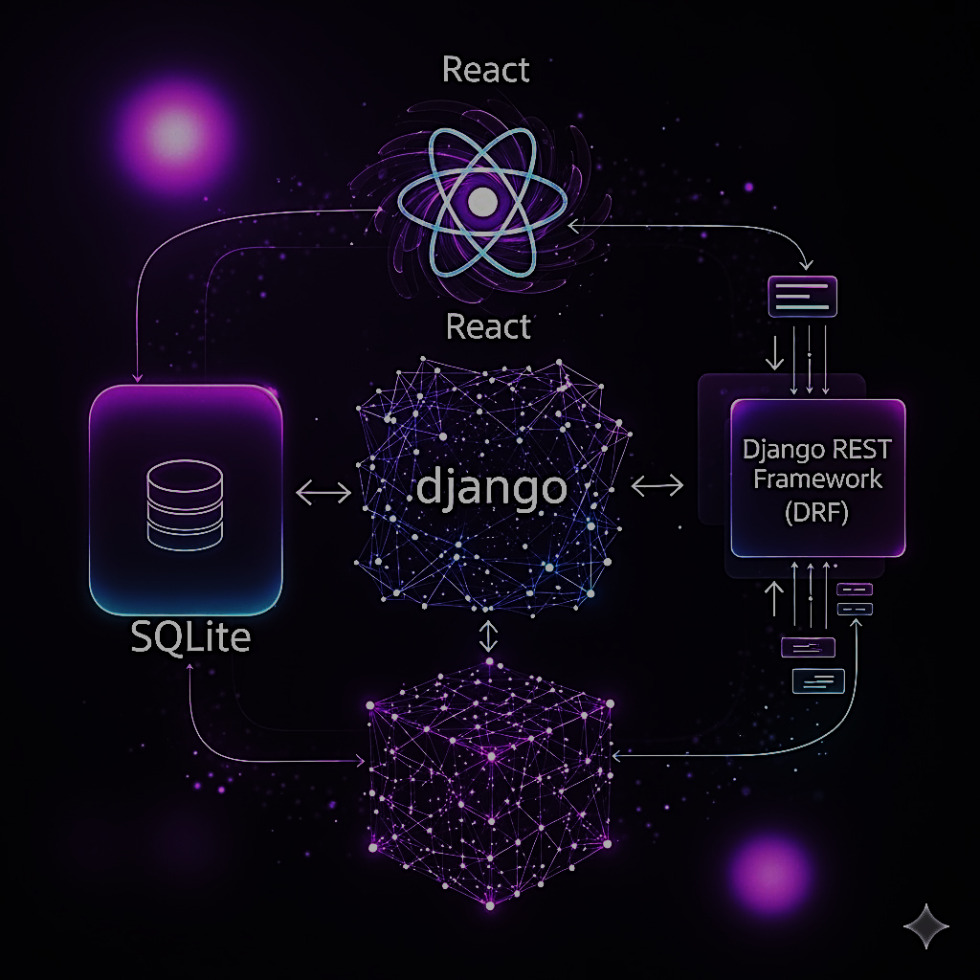
USER INTERFACE
Tech Stack: React.js Axios (API calls)
API Integration:
Axios instance (api.js) connects to Django REST API (http://127.0.0.1:8000/api/).
Uses useEffect to fetch data and useState to manage form inputs.

Slide 9
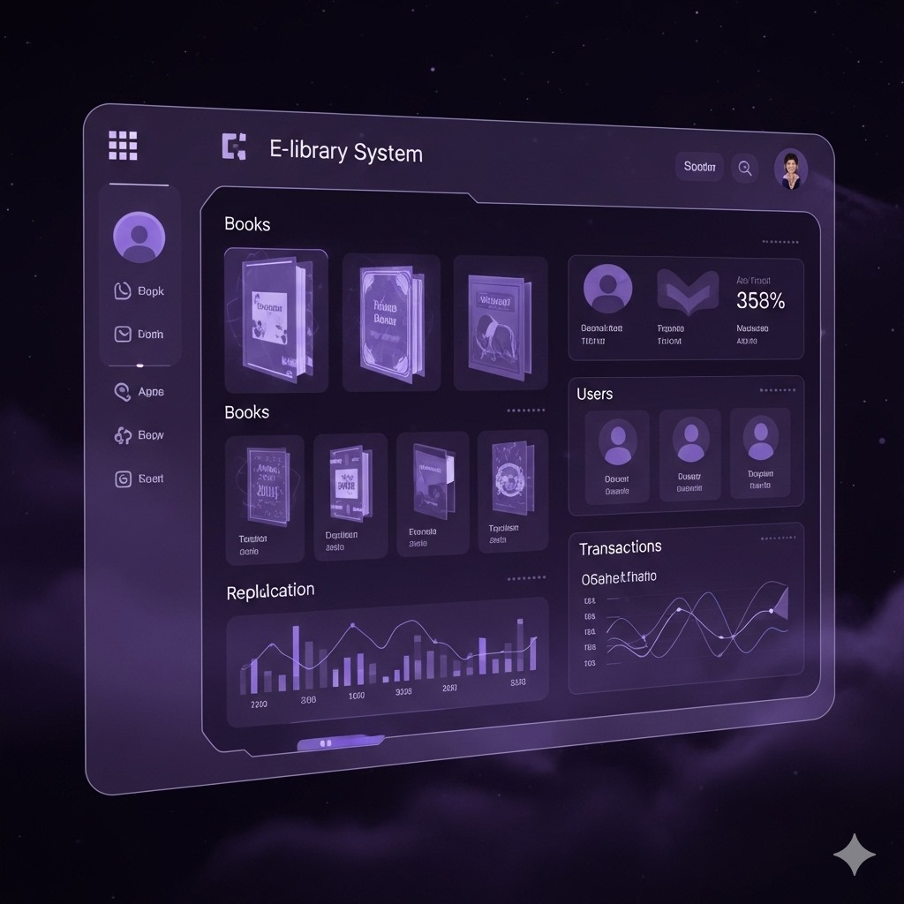
INTERFACE ENHANCEMENTS
3. UI Enhancements:
Dropdowns for selecting users/books.
Instant feedback messages ( success / error).
4. Availability now updates correctly:
Issue → Marks book as unavailable.
Return → Marks book as available again.

Slide 10
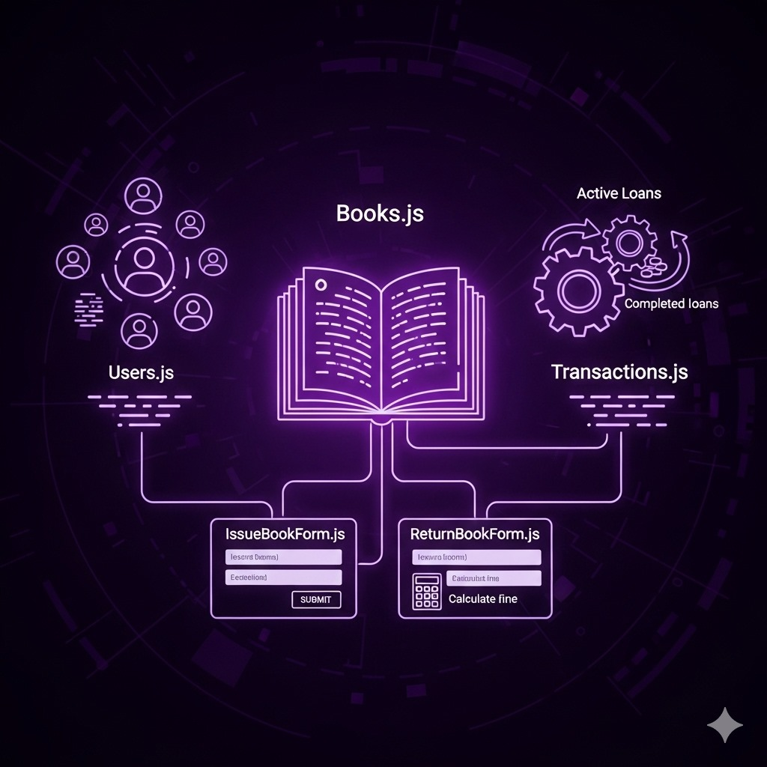

KEY COMPONENTS
Books.js List all books along with availability status of the book.
Users.js Show registered users on the frontend and store the users in the database.

Slide 11
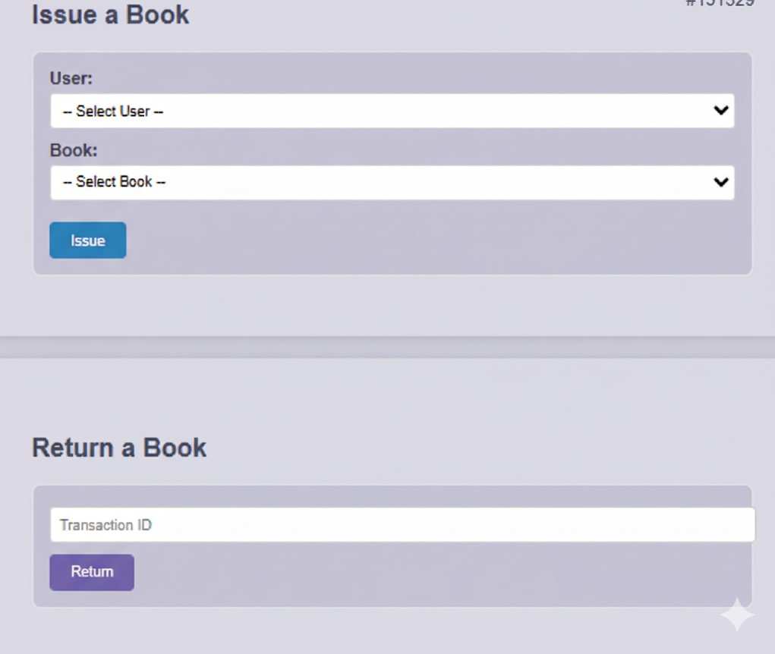
KEY COMPONENTS
3. Transactions.js Track active and completed loans of the users and store it
4. IssueBookForm.js Issue book with due date
5. ReturnBookForm.js Return book & auto fine shown

Slide 12
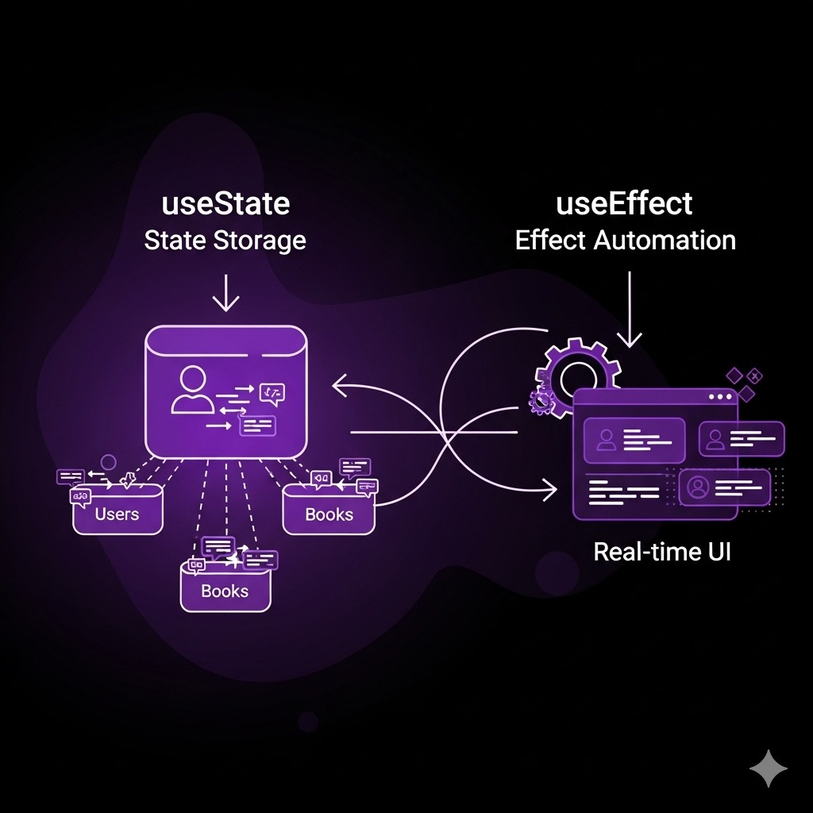
STATE MANAGEMENT IN REACT
useState Hook Stores dynamic data (users, books, transactions, form inputs).
useEffect Hook Automatically fetches data when component loads.
Ensures UI updates in real-time when issuing/returning books.

Slide 13
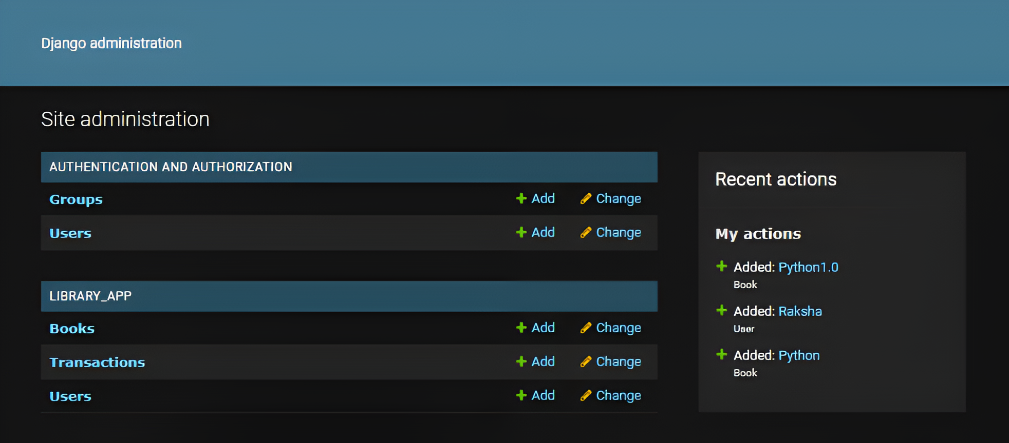
DJANGO ADMINISTRATION PANEL
Admin Site (Django Admin Panel)
Built-in Django feature to manage data easily.
Provides a web interface for Books, Users, and Transactions.
Admin can add, update, or delete records directly.
Useful for monitoring book availability, issued books, and fines.
Accessible at → http://127.0.0.1:8000/admin/.

Slide 14

BUSINESS LOGIC
Business Logic:
When a book is issued → Transaction
created, Book marked as unavailable.
When a book is returned → return_date
updated, Book marked available, fine
calculated automatically.
2. Error Handling:
Validates if a book is already issued.
Returns JSON errors for frontend to display.

Slide 15





SYSTEM DESIGN OVERVIEW
Modular Architecture
2. Data Layer
Backend: Models, Views, Serializers.
Frontend: Components (Books, Users, Transactions, IssueBookForm).
SQLite database with tables for Users, Books, and Transactions.
Data persists across sessions.
3.Application Layer
4. Logging Layer
Django REST API controls issuing, returning, fines, and user management.
Server logs for API actions; browser console for frontend errors.

Slide 16



SYSTEM DESIGN OVERVIEW
5. User Interface Layer
7. Error Handling
React-based UI with options to view, issue, and return books, plus track transactions.
Backend: validations, exceptions.
Frontend: form validation, error messages.
6. Data Flow
Input (React) → API (Axios → Django) → Database → JSON Response → UI update.

Slide 17
SYSTEM ARCHITECTURE
Technologies Used:
Models:
Frontend Components:
Storage:
Backend: Django, Django REST Framework, django-cors-headers
Frontend: React.js, Axios
Database: SQLite
Other: CORS Middleware, REST Router
User – Stores user details (user_id, name).
Book – Stores book details (book_id, title, author, isbn, available).
Transaction – Stores transactions and calculates fines.
Books.js – Displays list of books
Users.js – Shows registered users.
Transactions.js – Tracks transactions.
IssueBookForm.js – Allows book issue to a user.
ReturnBookForm.js – Handles return & fine calculation.
All persistent data (users, books, transactions) stored in SQLite database.
Logs:
Django Admin Panel tracks and manages all records of books, users, and transactions.

Slide 18
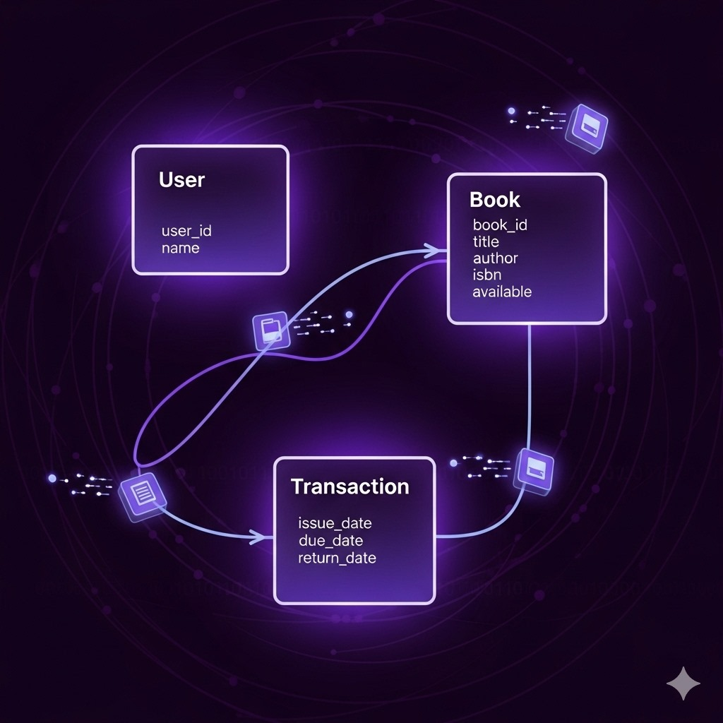
DATA MODELS
User
Fields: user_id, name
Stores basic information about library users
Book
Fields: book_id, title, author, isbn, available
Represents books in the library collection.
Transaction
Fields: issue_date, due_date, return_date
Links a User and a Book when a book is borrowed.
issue_date is when the book is borrowed.
due_date is the last day to return.
return_date is filled when the book is returned.

Slide 19
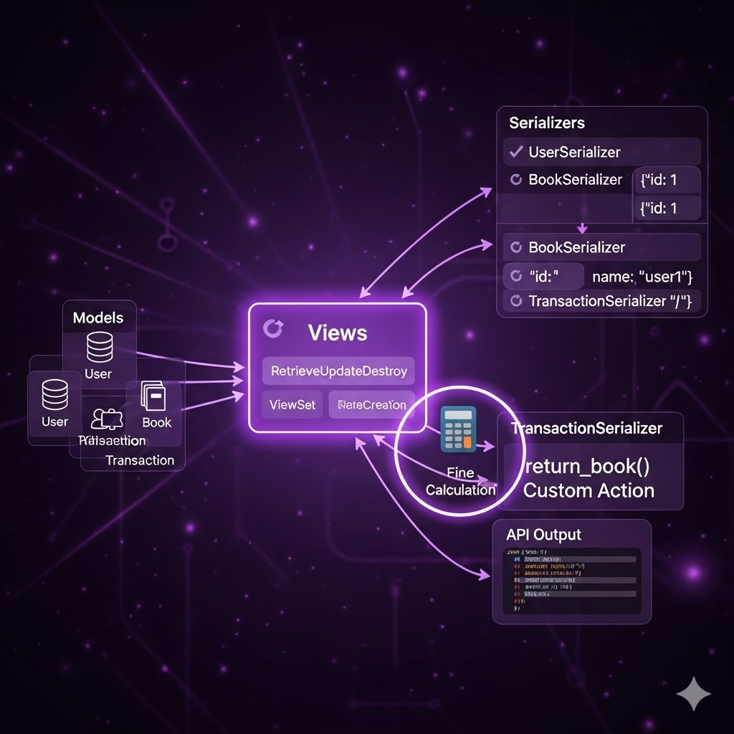

SERIALIZERS & VIEWS
Serializers
Convert Models → JSON
TransactionSerializer → calculates and returns fine.
Views
Implemented using ViewSets
UserViewSet
BookViewSet
TransactionViewSet
Custom Action: return_book() → updates availability & fine, sets return date

Slide 20
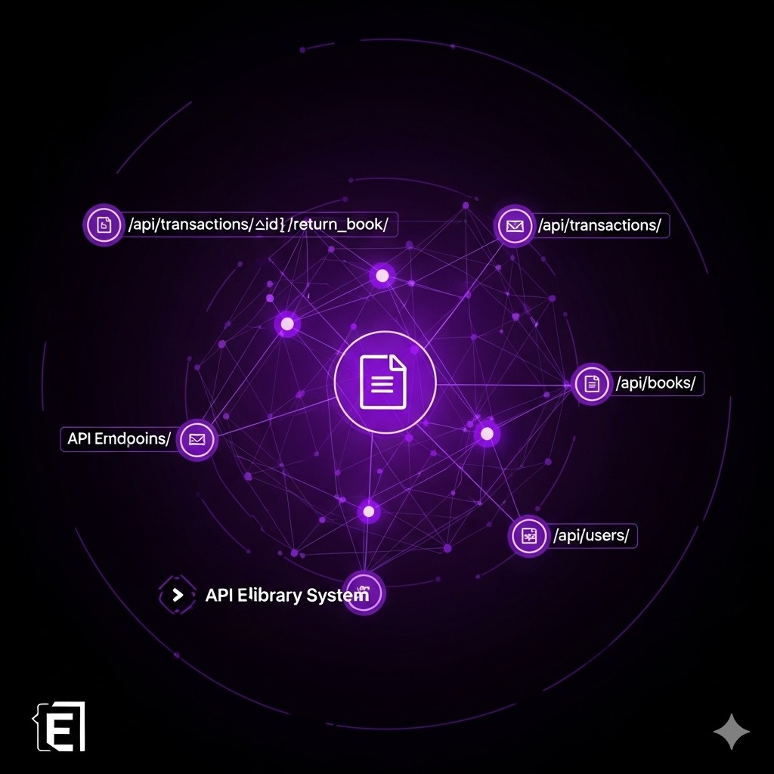
API ENDPOINTS
/api/transactions/{id}/return_book/
Return a book + fine calculation
/api/transactions/
Issue & track loans
/api/books/
Manage books
/api/users/
Manage users

Slide 21
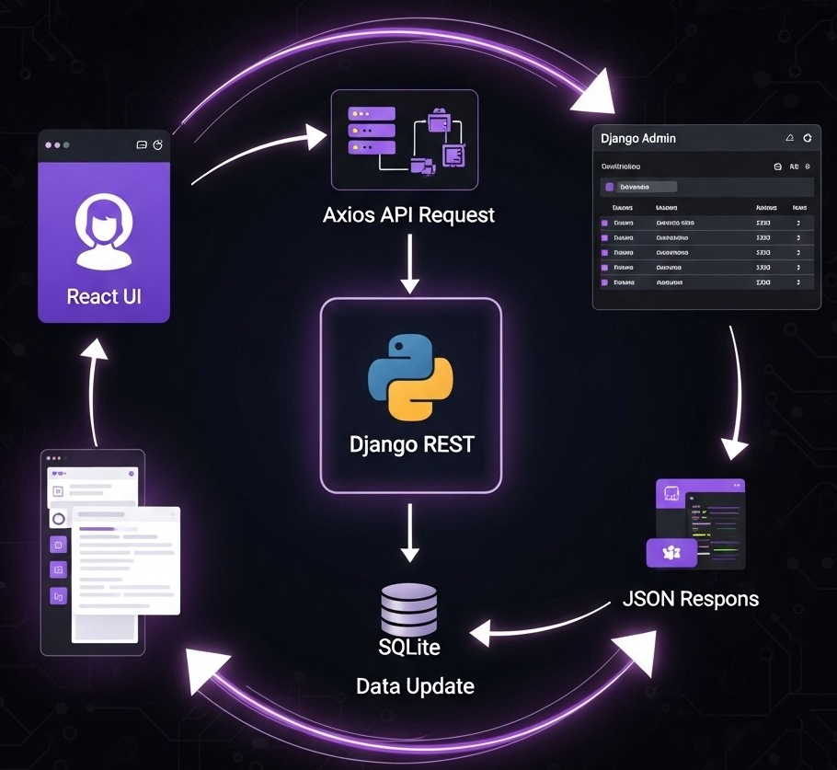
SYSTEM WORKFLOW
User selects an action from the React frontend.
Frontend sends API request via Axios to the Django REST backend.
Backend processes the request and updates the SQLite database
Django Admin panel reflects all updates for monitoring and management.
Backend returns JSON responses, and the frontend updates UI with latest data

Slide 22
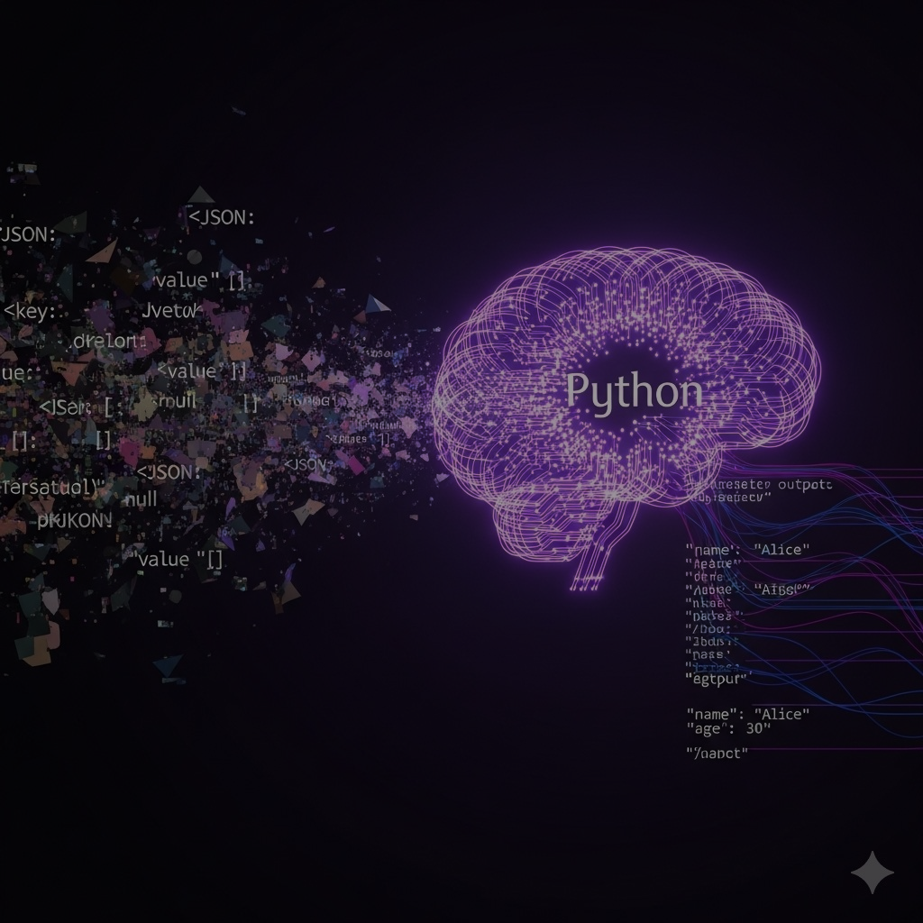
COMMAND-LINE VERSION
A lightweight library management system built purely with Python.
Runs as a Command Line Interface (CLI) for easy usage without a web server.
Designed to manage books, users, and transactions with persistent storage.
Uses JSON files for saving data and log files for tracking system activities.
Provides a simple yet effective way to issue, return, and monitor books.

Slide 23
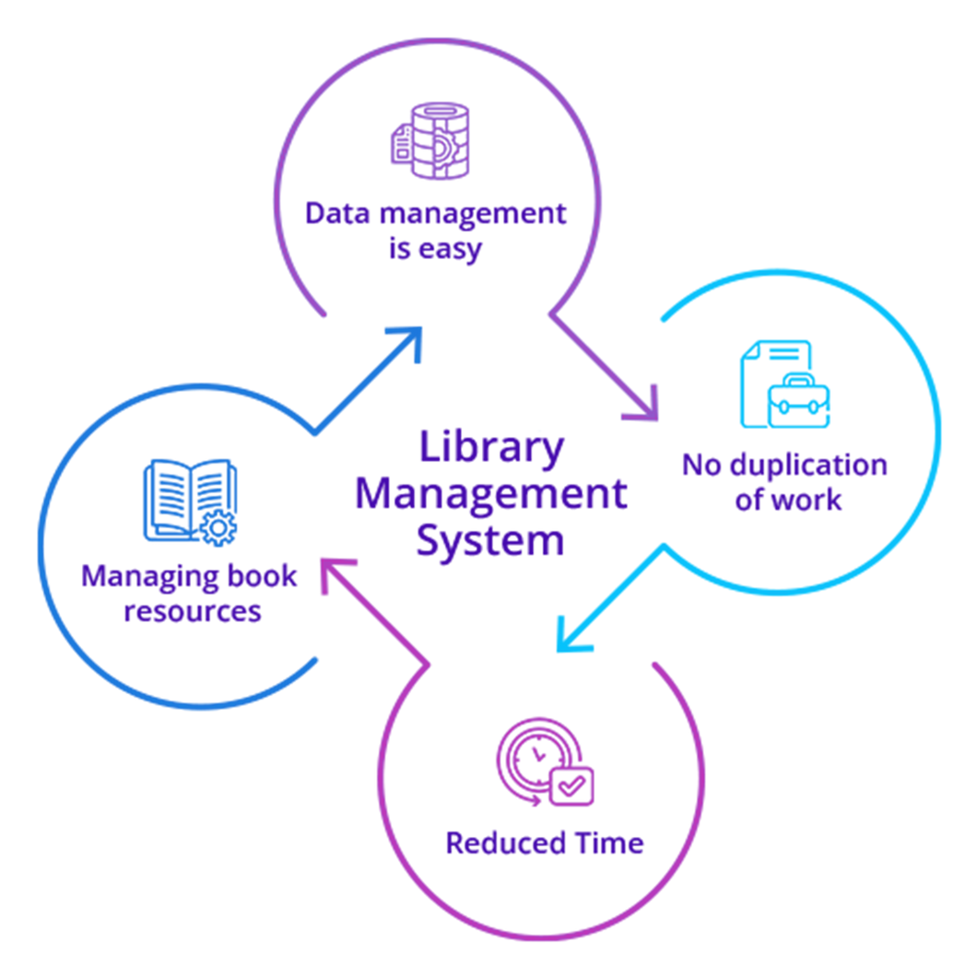
CLI ARCHITECTURE
Modules : json, os, datetime, logging.
2. Classes:
i. Book : stores book details.
ii. User : stores user details.
3. Library System : handles operations
4. Storage: All data stored in JSON file.
5. Logs: System activities stored in a log file.

Slide 24
NON-FUNCTIONAL REQUIREMENTS
FUNCTIONAL REQUIREMENTS
Easy-to-use Command Line Interface (CLI)
Data consistency between sessions (via library.json)
Logging of activities (library.log) for tracking
Error handling for invalid inputs
Add and remove books
Register new users
Issue and return books with due dates
Calculate fines for late returns
Display available books,registered users, and active loans
Maintain persistent storage using JSON
TOOLS & ENVIRONMENT
Python 3.10 or 3.12 installed
PyCharm
Command line / terminal to run the program

Slide 25

SYSTEM ARCHITECTURE-CLI VERSION
User selects an option from the menu.
System checks data and performs the requested operation.
Transactions (issue/return) are saved in JSON file.
Logs are updated for each action.
User can view current books, users, and issued records anytime.

Slide 26

KEY FUNCTIONS
add_book()
remove_book()
register_user()
Deletes a book if available
Registers a new user
Adds new books to the system.
issue_book()
list_books()
list_users()
Displays registered users
Issues book with due date.
Shows all books with status

Slide 27
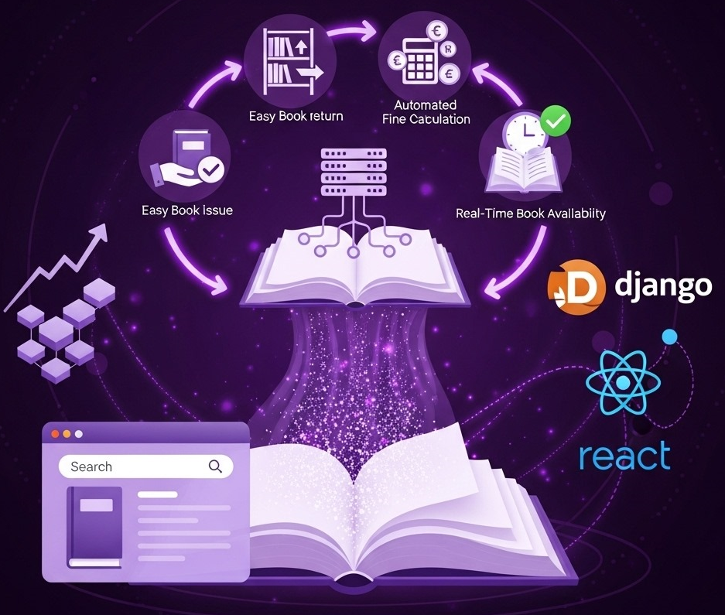
ADVANTAGES
Easy online book issue & return.
Auto fine calculation for late returns.
Real-time book availability tracking.
Centralized database for all records.
Accessible via web browser on any device.
Scalable with Django + React structure.
Clear tracking of all transactions.

Slide 28

CURRENT SCOPE & CONSTRAINTS
Limited to single-user database (SQLite).
No offline access; requires browser.
Basic CRUD only; advanced search/filter not supported.
Single-server setup.
No real-time updates; frontend updates via API fetch.

Slide 29

FUTURE ENHANCEMENTS
Multi-user support & scalable database (PostgreSQL/MySQL).
Advanced search & filtering by author, category, or keywords.
Real-time updates & notifications for book issues/returns.
Book reservation & renewal online.
Improved UI/UX – responsive design with dashboards.

Slide 30




CONCLUSION
The project successfully simulates a real-world library management system, automating book issue, return, and fine calculation.
AutomatesIt is built as a full-stack application using Django and React, providing a modern and user-friendly interface. issue and return with fine calculation.
SQLite database is used for persistent storage, ensuring reliable management of records.
The system is modular and extensible, making it easy to add future features like authentication, reporting, and GUI enhancements.
Overall, it is a complete mini project for library automation, offering a solid foundation for further development and improvements.

Slide 31
THANK YOU

